Slide 1
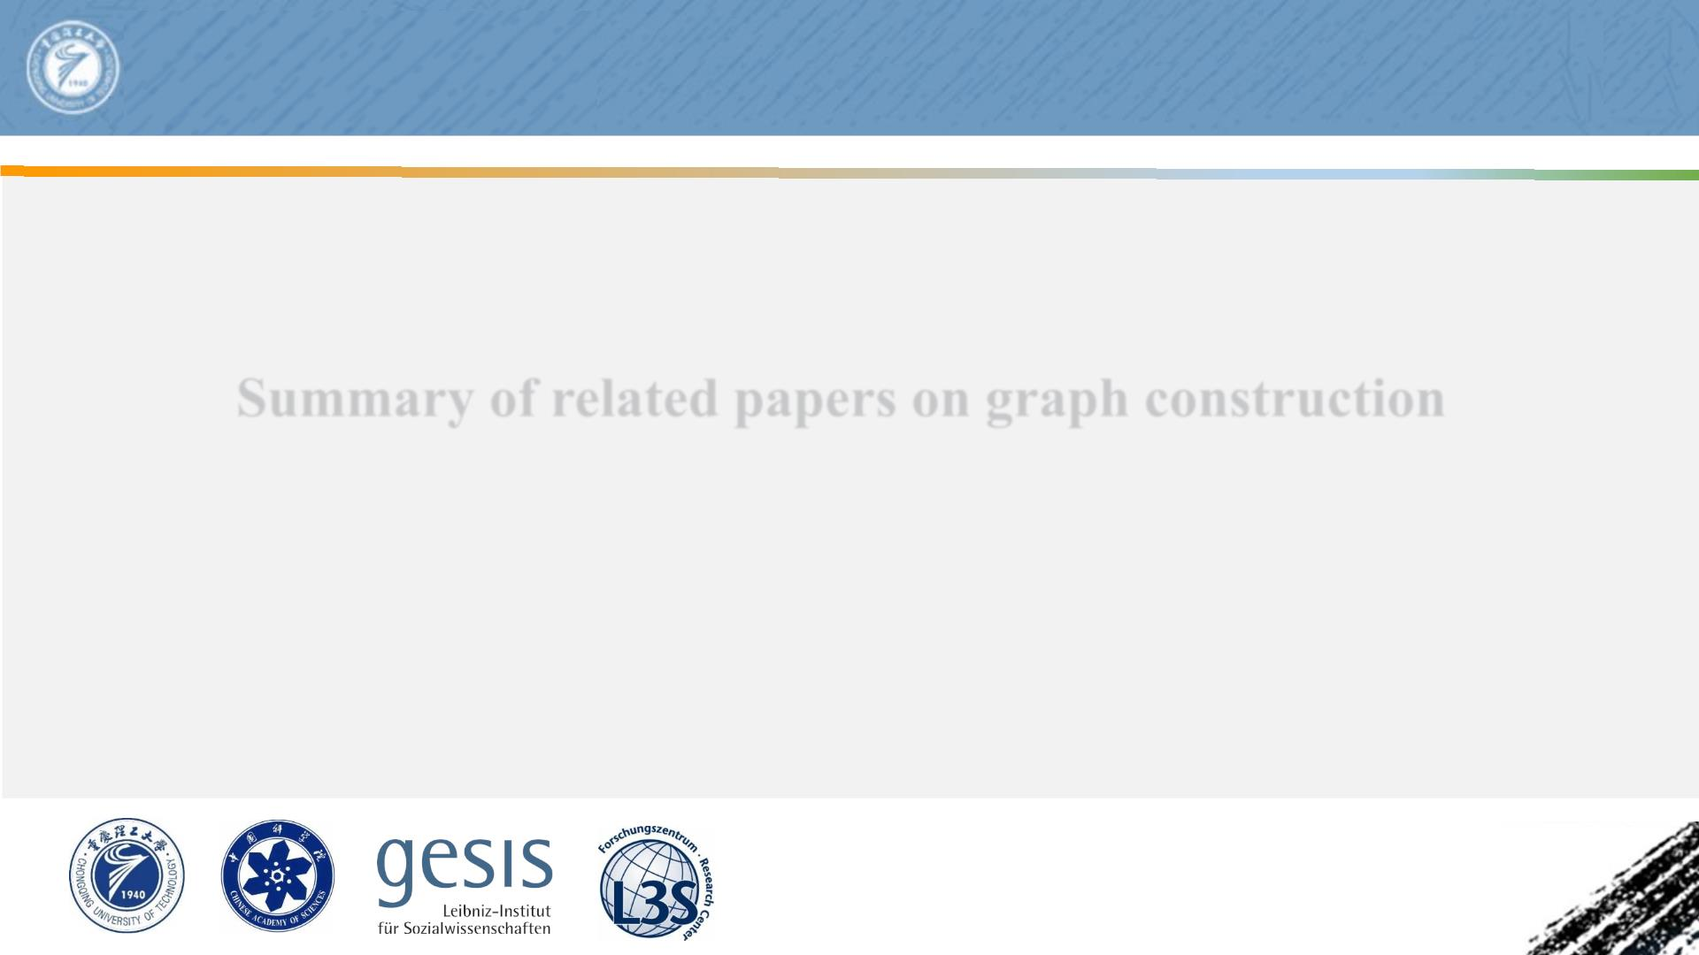
Chongqing University of
Technol ogy
ATA I
Advanced Technique of
Artificial Intel l i gence
Summary of related papers on graph construction
Reported by Yidan Liu

Slide 2
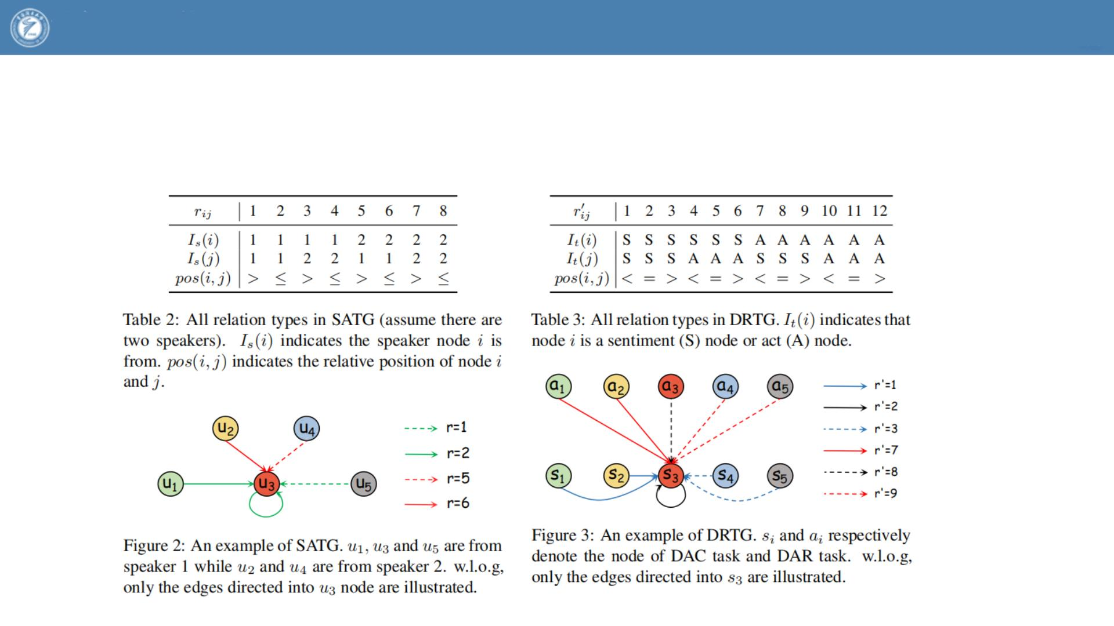
Chongqing University
of Technology
ATAI
Advanced Technique of
Artificial Intelligence
2022_ACL_DARER_Dual-task Temporal Relational Recurrent Reasoning Network for Joint Dialog Sentiment
Classification and Act Recognition

Slide 3
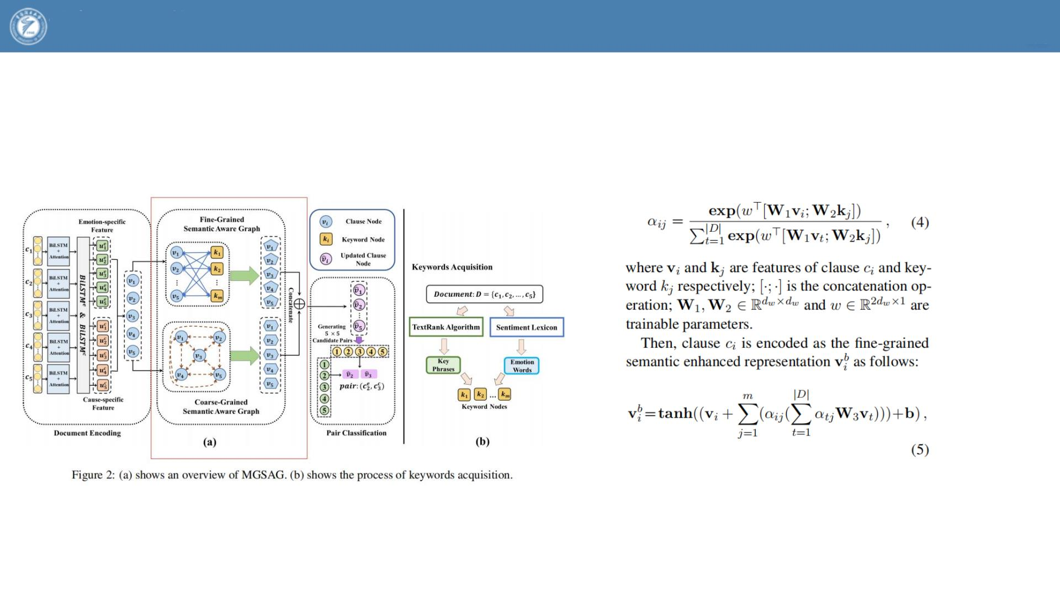
Chongqing University
of Technology
ATAI
Advanced Technique of
Artificial Intelligence
2022_ACL_Multi Granularity Semantic Aware Graph Model for Reducing PositionBias in Emotion-Cause Pair Extraction

